Slide 1
Cloud Computing – a simple Explanation
Jere Minich
Program Director
Lake-Sumter Computer Society
Leesburg, Florida
49 Slides

Slide 2
Overview for today
1. What is Cloud Computing.? ( acronym = CC)
2. Strengths & Free CC.
3. Why Business Needs CC.?
4. Types of CC.
5. How CC works.?
6. Positive/Advantage of CC.
7. What is CC like.?
8. Access, Security, Privacy, Public Records.
9. CC & Me; Service & Infrastructure
10 Benefits
11. A look into the future
  Google, Ajax, Mobile, BYOD.
42 –Slides-most- Black & White – Available as: Power Point 2007, PDF, Wordpad.

Slide 3
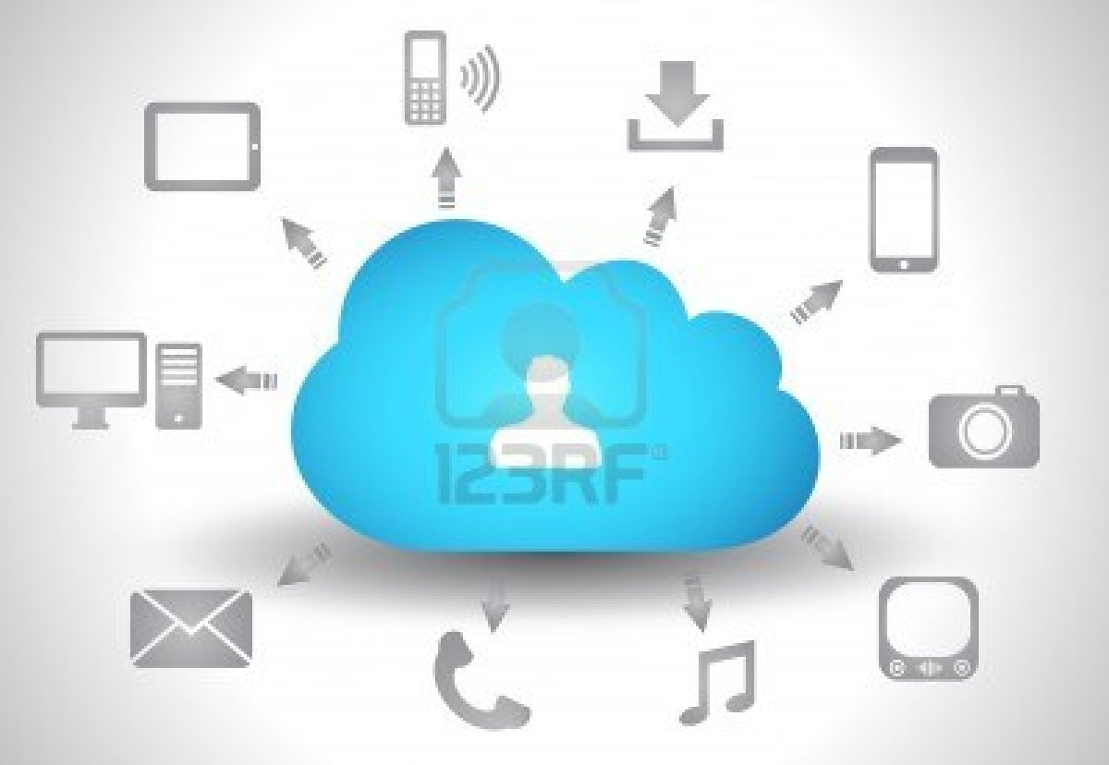
Cloud Computing concept background with a lot of icons: tablet, smartphone, computer, desktop, monitor, music, downloads and so on

Slide 4
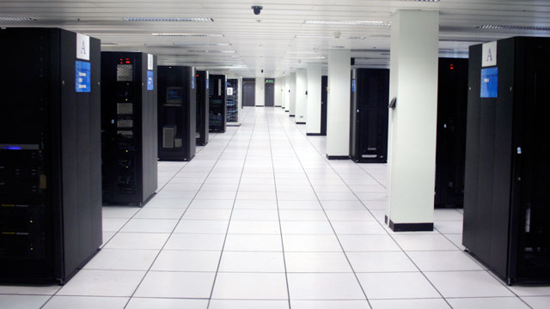
Cloud Computing Complex

Slide 5
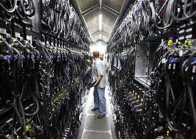
Inside Look

Slide 6
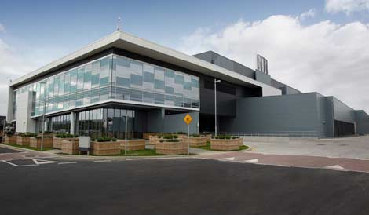
A view of the Microsoft data center in Dublin, Ireland.

Slide 7
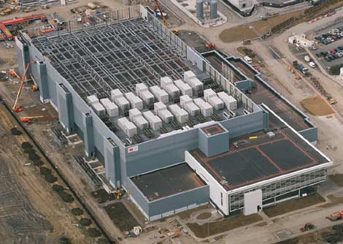
Another view of the Microsoft data center in Dublin, Ireland.

Slide 8
Cloud computing is where:
software applications,
processing power,
Data
or artificial intelligence
are accessed over the Internet.

Slide 9
Cloud computing is:
the ability to employ a number of:
  computers,
  hardware,
  software,
  and servers - a computer program running to serve the requests of other programs,
to serve your computing needs remotely
  without actually owning or running the software and hardware.

Slide 10
Cloud computing is:
A much-needed technology that provides:
  resources over the Internet,
  which are:
    extremely accessible
    and informative as a service
to those who use Cloud Computing.

Slide 11
The strength of cloud computing is:
that it is instantly scalable;
  in other words:
  more computers can be;
    added to
    or removed from
  the cloud at any time,
  without impacting the operation of the cloud.
Therefore:
  there are virtually unlimited:
    processing
    and storage capabilities
to any user.

Slide 12
There are numerous free cloud computing services, like:
Hotmail,
Gmail,
Yahoo! Mail,
YouTube
Facebook
Microsoft
Google,
Amazon,
IBM.
there are also a number of options that users can purchase on-demand to meet their specific needs.

Slide 13
Why Businesses Need Cloud Computing
Government agencies, the military, research laboratories, and universities use:
  supercomputers to perform complex tasks such as:
    analyzing climate change,
    solving medical problems,
    ensuring our national security.
Cloud computing: (which makes trillions of calculations per second)
  is intended to provide similar power.
Users can estimate:
  the risk in businesses ventures,
  store patients’ medical information,
  and analyze sales data
by making use of the Internet. ‘Cloud Computing’

Slide 14
Types of Cloud Service
As a rule, this concept involves some combination of:
  platform as a service (PaaS),
    compute and storage resources scale automatically to match application demand
  software as a service (SaaS),
    cloud providers install and operate application software
  and infrastructure as a service (IaaS).
    providers offer computers – as physical or more often as virtual machines –, raw (block) storage, firewalls, and networks
    For the typical business, overall computing costs remain the same.
  and the provider of the service absorbs the upfront costs,
  spreading them out over time.

Slide 15
How Cloud Computing Works
Accessed through the Internet:
  the off-site cloud computing is usually provided by a third party,
and less technological skill is needed for the user’s in-house implementation.
This should be weighed against:
  possible security risks,
  along with loss of access and control.

Slide 16
Positive/Advantages of Cloud Computing
Those who use cloud computing achieve:
  location and device independence,
    Mobile devices
  they can use a web browser to access various systems
    from any site
    with a variety of devices.
      Computer
      Tablet
      Smart Phone

Slide 17
Some Other Advantages to Using Cloud Computing
● Costs and resources are shared in a sizable pool of cloud computing users,
  the infrastructure is centralized by the provider,
    resulting in lower costs for them.
  Because of its reliability at multiple sites,
    provides business continuity
    helps to ensure disaster recovery for the user.
  Resources are provided on a “scalability” basis,
    the system is closely monitored,
    businesses do not have to plan for when peak loads will be needed.
  Providers are able to devote their resources to resolving security problems,
    which many businesses could not afford to do.
  Better utilization of resources,
    more efficient systems often result in improved long term use of the user’s computer system.

Slide 18
What Cloud Computing is Like
Most individuals who surf the Internet are already familiar with cloud computing:
  although they may not know it.
If you’ve ever used:
  a Web-based email,
  stored and shared photos online,
  looked something up on Wikipedia,
  stored data with Microsoft (Skydrive)
you’ve entered “the cloud.”

Slide 19
Cloud Access
Access files across PC or Mac
  installed on all your computers, you'll have automatic access to the latest version of your files wherever you are.
Simple sharing with anyone
  Share even large files and photos with your friends.
  All they need is a web browser—
  no worrying about attachment limits or what software they have.
Mobile access
  Photos and files in the folder on your PC are automatically available on your phone.
  Get the app or just use the phone's browser.

Slide 20
With cloud computing
your information is “hosted remotely”:
  instead of taking up space on your hard drive
  and necessitating a complex matrix of:
    servers,
    bandwidth,
    networks,
    hardware,
    software
    and storage space.

Slide 21
Security – A big question
Since -there is no one single location where the information is stored.
  This actually increases its security.
  The same safeguards and roadblocks apply as to any Web site you visit for personal reasons:
    layers of security packets,
    passwords
    and authentication
  are all required before you can access information that may be sensitive.

Slide 22
Security
every application you use can be custom-built to your specifications,
  it becomes easier to encrypt and safeguard this Information.
Applications are stored on a server:
  eliminating the need to install any software for users to be able to use a program.
  These applications can be accessed and used from any web browser.
  Example – go anywhere on get on Facebook.
Everything is updated in real-time
  everyone who’s authorized to access the information can view the latest results and statistics immediately,
    without performing complicated analysis.

Slide 23
Cloud Security
issues fall into two broad categories:
Security issues faced by cloud providers:
  organizations providing
    Software-,
    Platform-,
    or Infrastructure-as-a-Service via the cloud)
2. Security issues faced by their customer

Slide 24
Cloud Security and privacy
Identity management - Every user will have its own identity management system to control access to information and computing resources.
  Cloud providers either integrate the customer’s identity management system into their own infrastructure,
  or provide an identity management solution of their own.
Physical and personnel security - Providers ensure that:
  physical machines are adequately secure
  access to these machines
  and relevant customer data is:
    not only restricted
    but that access is documented.
  Cloud providers assure customers that they will have:
    regular and predictable access to their data and applications.
Application security - Cloud providers ensure that applications available as a service via the cloud are secure by implementing:
  testing and acceptance procedures for outsourced or packaged application code.
  It also requires application security measures be in place in the production environment

Slide 25
Cloud Security
Privacy - providers ensure that all critical data:
  credit card numbers, for example
  are masked
  and that only authorized users have access to data in its entirety.
Digital identities and credentials must be protected.
  as should any data that the provider collects or produces about customer activity in the cloud.
Legal issues - providers and customers must consider legal issues, such as:
  Contracts and E-Discovery, (discovery in civil litigation which deals with the exchange of information in electronic format )
  the related laws, which may vary by country

Slide 26
Public records
Legal issues may also include:
  records-keeping requirements in the public sector,
where many agencies are required by law to retain and make available electronic records in a specific fashion.
This may be determined by legislation, or law may require agencies to conform to the rules and practices set by a records-keeping agency.
Public agencies using cloud computing and storage must take these concerns into account.

Slide 27
I understand this concept, but how is it affecting me, my family?
Software as a Service:
  is not strictly a Cloud Computing concept.
It’s simply the idea that a web platform such as Google Docs can give:
  people all the functionality of software installed on their computer,
  without the need to install anything beyond a browser.
benefits from the cloud because the cloud makes it very scalable. (Changing use and price)

Slide 28
The idea behind platform as a service:
is that resources are made available for building whole applications as components,
  rather than programs to be written.
    Widgets,
    web editors,
    pre-built shopping carts,
    whatever pieces you need could be offered by a single vendor for the user to mix and match at will.
  The vendor provides enough infrastructure to support :
    easy scaling
    changing charges,
    cloud-fashion,
  for your personal use.

Slide 29
Infrastructure
as service is where cloud computing is currently strongest and showing the most innovation.
This is something like Amazon’s Elastic Compute Cloud, that allows you to ramp up virtual servers in a short time to meet transitory demand.

Slide 30
How is the average end-user affected by cloud computing?
Is the average person who sits down to surf the Web participating in cloud computing?
If cloud computing is done right, it should be completely transparent to the end user.
They should never know if there is one computer behind the scenes or a thousand.
They should never have to think about what continent the software is hosted on or see a delay because of increased demand.
If someone writes a Google app, they aren’t “participating” in cloud computing.
  They’re just using an app, no different from any other as far as they are concerned.

Slide 31
3 Big Benefits
1. Presence.
  I can access this document from the computer I am sitting in front of now.
  If it lived in Google Docs, I could get to it from any computer with an Internet connection.
2. cost.
  With Google docs, I don’t have to pay for Microsoft Word.
  With Amazon EC2 or S3, I don’t have to buy a lot of hardware or hire people to maintain it.
  These are non-trivial costs that are being avoided.
3. redundancy.
  By definition a cloud vendor has lots of resources available for use.
  If a hard drive or two, or even a server or two, fail in their cloud infrastructure, there is enough redundant capacity to take up the slack so that end users won’t even notice.
  Improving uptime without a commensurate increase in end user cost is part of what the cloud is about.

Slide 32
Google & Cloud
Cloud computing from Google Docs:
  a suite of free online office applications that includes:
    a word processor
    a spreadsheet,
    to ‘Wolfram|Alpha’, a "decision engine" that can perform sophisticated calculations.
      Answer questions,
      do math,
      instantly get facts,
      create plots,
      calculators,
      unit conversions,
      scientific data and statistics,
      help with homework—and much more.
    the iPhone app Shazam can recognize what song is playing on the radio:
      but it isn't the iPhone that is doing the heavy lifting
      the app is simply transmitting the information to 'the cloud' (Shazam servers on the Internet) to break down the music and find the song.

Slide 33
Asynchronous Javascript And XML.
AJAX has allowed for better and more intuitive web applications, the web page can be more responsive and act more like an application without always requiring us to click on links and reload the page.
  web mashups - allow for unique and interesting new combinations of applications,
  the social web has put us into the web as active participants,
  but it is cloud computing that is taking the web to the next level by turning it into a platform.

Slide 34
The Final Analysis
In the end, this means:
  we won't be tied to a specific operating system like Microsoft Windows
  we won't need an expensive computer.
  we can rely on the Internet to power the applications
  while we access it through a relatively cheap 'terminal' of a computer.

Slide 35
the tip of the iceburg
Google is leveraging its ‘Chrome browser’ and turning it into an operating system
  in order to create cheap "terminals" capable of access the web and running sophisticated applications through the rise of cloud computing.
And HTML 5, the new web standard currently being worked on, will allow for even more sophisticated applications.

Slide 36
A Look into the near Future
On February 7, 2012, Google launched Google Chrome Beta for ‘Android 4.0’ (Ice Cream Sandwich) devices.
  Since April 2009, each Android version has been developed under a codename based on a dessert or sweet treat. These versions have been released in alphabetical order: Cupcake, Donut, Eclair, Froyo (frozen yogurt), Gingerbread, Honeycomb and Ice Cream Sandwich.
In March 2012 Google announced it was working on a version of Chrome for both the ‘Metro’ and desktop versions of ‘Windows 8’.
  Windows 8 will employ a new user interface based on Microsoft's Metro design language.
  The Metro environment will feature a new tile-based Start screen similar to the Windows Phone operating system.
  Each tile will represent an application, and will be able to display relevant information such as:
    the number of unread messages on the tile for an e-mail app
    the current temperature on a weather application.

Slide 37
Mobile Cloud Computing exists:
when tasks and data are kept on the internet
  rather than on individual devices,
  providing on-demand access.
Alibaba Group launched cloud computing-based operating system July 2011. (China Based Company)
  The Aliyun operating system will feature cloud services such as:
    email
    Internet search and support for web-based applications.
Users are not required to download or install applications onto their mobile devices.

Slide 38
Definition
Mobile cloud computing
a combination between:
  mobile network
  and cloud computing,
thereby providing optimal services for mobile users.
In mobile cloud computing, mobile devices do not need a powerful configuration:
  (e.g., CPU speed and memory capacity)
since all the data and complicated computing modules can be processed in the clouds.

Slide 39
Example: Mobile Healthcare
Telecommunication technology in the medical field helped diagnosis and treatment become easier for many people.
This can helps patients regularly monitor their health and have timely treatment.
Also, it leads to an increase accessibility to healthcare providers, more efficient tasks and processes, and the improvement about quality of the healthcare services.
It also has to face many challenges (e.g., physical storage issues, security and privacy, medical errors).

Slide 40
Mobile Healthcare (Continued)
Cloud computing is introduced as a solution to address aforementioned issues.
  Cloud computing provides the convenience for users to help them access resources easily and quickly.
  It offers services on demand over the network to perform operations that meet changing needs in electronic healthcare applications.

Slide 41
Example: Mobile Computing
As mobile computing has become more popular over the past decade, it has been under continuous development with advances in:
  hardware,
  software
  and network.
With mobile computing we can check:
  our email messages,
  our bills,
  our bank accounts
  and our other private information
just by using a mobile phone or laptop anywhere.
All the functionalities obligate each exchange of data to make it safe and immune from any attack.
Mobile computing services have simplified our lives. (??)

Slide 42
A cloud client
consists of:
  computer hardware
  and/or software
that relies on cloud computing for application delivery.
A Partial List……
Android (operating system), Baidu Yi, Cherrypal, Google, Chrome, Chromebook, Chromium (web browser), Cirtas, Cloud storage gateway, CloudBook, Comodo Dragon (web browser), CyanogenMod, GOS (operating system), Internet OS, Iphone, Joli OS, Legacy-free PC, MIUI, Netbook, Nettop, OG-OS, OMFGB, Ophone, Plug computer, Replicant (operating system), SRWare Iron, StorSimple, Windows Phone, Zonbu

Slide 43
Business Outlook
Mobile computing appears to be a driving force behind cloud adoption in enterprises.
while cloud computing delivers cost savings,
  it only amounts to a few pennies (relatively speaking)
providing better connectivity to employees’ mobile devices is the reason companies are so interested in cloud computing.

Slide 44
Bring Your Own Device (BYOD)
describes the recent trend of people bringing personally-owned mobile devices to their place of work or school.
Mobile devices are now found:
  in the hands of most children,
  school leaders are using that to their advantage by:
    incorporating devices that students already own into classroom lessons and projects.

Slide 45
Pros of BYOD in Schools
1. Students MORE likely to have remembered devices than pencils etc
2. Can use the device THEY have chosen to complete set tasks.
3. Technology is ubiquitous outside the school gates. Why not inside too?
4. If BYOD is not allowed, then we're teaching to the lowest common denominator
5. When students use their own devices, they take care of their own 'training.‘
6. Usage of BYOD is seen as a privilege & students stay on task.
7. BYOD offers potential cost savings since fewer school devices are needed.
8. BYOD allows student & teacher to swap roles.
9. BYOD offers learning opportunities at times the students choose.

Slide 46
Pros of BYOD in Schools
10. BYOD creates emotions such as enthusiasm, vitality, and zest all of which are related to curiosity.
11. Reduces expenditure on stationery.
12. BYOD extends the tech resources already provided by school.
13. BYOD encourages purposeful choice of appropriate tools/apps.
14. BYOD in school provides opportunity for teaching respectful/appropriate use.
15. On average BYOD can help keep pace with ever-updating tech.
16. New horizons may become apparent when students are choosing their paths.
17. BYOD could be pivotal in supporting independent learning.
18. BYOD offers a way of delivering e-book

Slide 47
Cons of BYOD in Schools
1. Students leave chargers at home. Devices run out of power.
2. Exacerbates issues of inequity of access.
3. Students forget to bring devices.
4. Technical infrastructure may need addressing before implementation. Expensive.
5. BYOD will encourage students to be 'off task.‘
6. Pens & paper don't require infrastructure.
7. Applications/tools are not common to all platforms.
8. BYOD runs up against many schools' 'ban em' policies. (Mobile Devices)
9. Planning for a lesson with devices whose capability you don't know needs more care & thought.
10. Expensive personal devices increase possibility of theft.

Slide 48
Cons of BYOD in Schools
11. Many teachers aren't flexible or willing enough to take risks trying BYOD.
12. Emphasis of tech support will need to shift from network to user .
13. Teachers will need instructional PD in getting the most from BYOD.
14. Teachers may find themselves troubleshooting tech instead of guiding learning.
15. Parents may not be comfortable with paying for device/access for use in school.
16. Some students may be unhappy mixing school work on their personal device.
17. Accessing school network can present problems w/ WiFi/Proxy settings etc
18. Currently, BYOD doesn't help prep for external exams.
19. Tech can become a status symbol to flaunt.
20. Greater opportunities for plagiarism exist with BYOD

Slide 49
How to manage tech change in a BYOD and cloud world ?
Good Question.
The End…….
Jere Minich
ProgramLSCS@gmail.com

